Slide 1

Memory Technologies Spring 2024
Hamed Farbeh
farbeh@aut.ac.ir
Department of Computer Engineering
Amirkabir University of Technology

Slide 2
Reference
Memory Systems: Cache, DRAM, Disk, Bruce Jacob, Spencer W. Ng, and David T. Wang, Morgan Kaufmann, 2008
Memory Technologies, Spring 2024, AUT, Tehran, Iran

Slide 3
Cache Principles
Caches are transparent memories
They work independently of the client making the request
Have built-in heuristics that determine what data to retain
Caches that are explicitly managed by the client making the request are called: scratch-pads or scratchpad memories (SPMs)
Locality Principles
Temporal Locality
Spatial Locality
Anything else?
Algorithmic Locality
When a program repeatedly accesses data items or executes code blocks that are distributed widely across the memory space
Memory Technologies, Spring 2024, AUT, Tehran, Iran

Slide 4
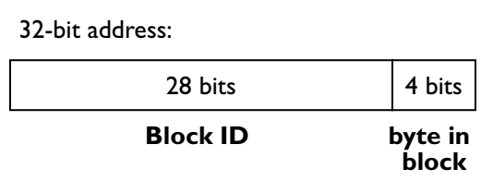
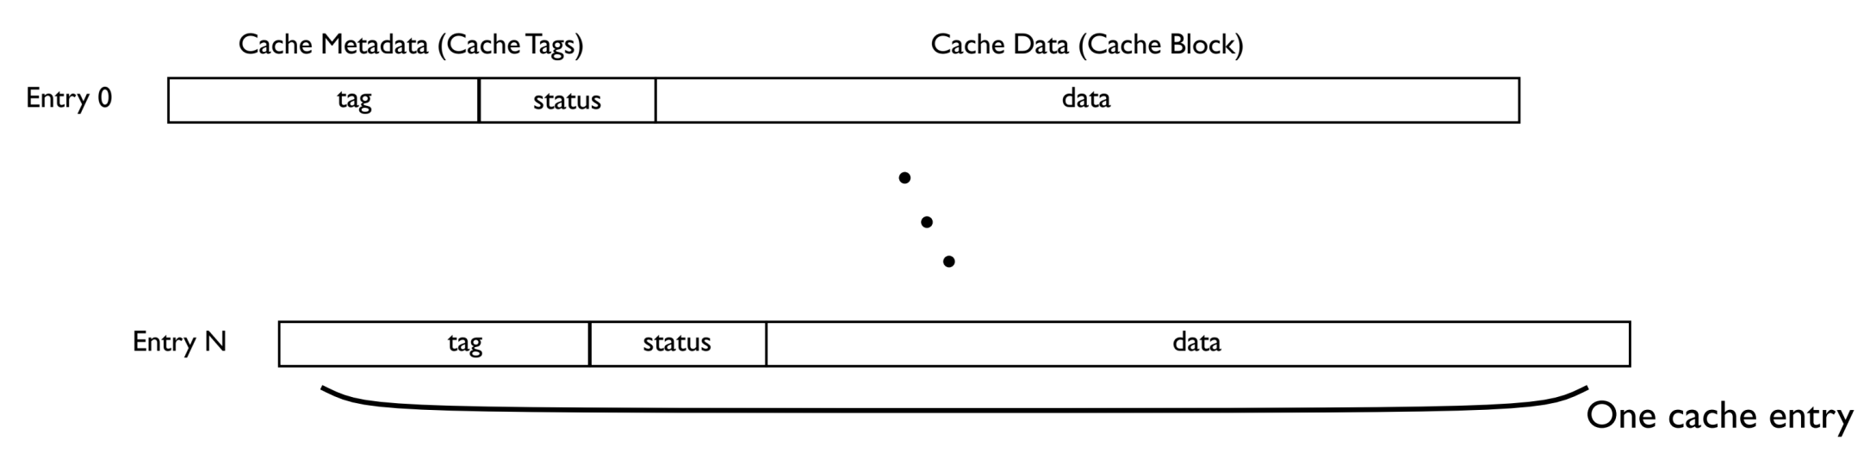
Logical Organization Basics
Blocks, sets, tags
Memory Technologies, Spring 2024, AUT, Tehran, Iran

Slide 5
Content Management
To Cache or Not to Cache
determine which references are the best candidates for caching and to ensure that their corresponding data values are in the cache at the time the application requests them
must consider the currently cached items and decide which should be evicted to make room for more important data not yet cached
Cache Replacement algorithms
Memory Technologies, Spring 2024, AUT, Tehran, Iran

Slide 6
Consistency Management
Keep the cache consistent with itself
There should never be two copies of a single item in different places of the cache, unless it is guaranteed that they will always have the same value
Keep the cache consistent with the backing store
The value kept in the backing store should be up-to-date with any changes made to the version stored in the cache
Write-back and write-through policies
Keep the Cache Consistent with Other Caches
Other caches in the system should all be treated much like the backing store in terms of keeping the various copies of a datum up-to-date
Memory Technologies, Spring 2024, AUT, Tehran, Iran

Slide 7
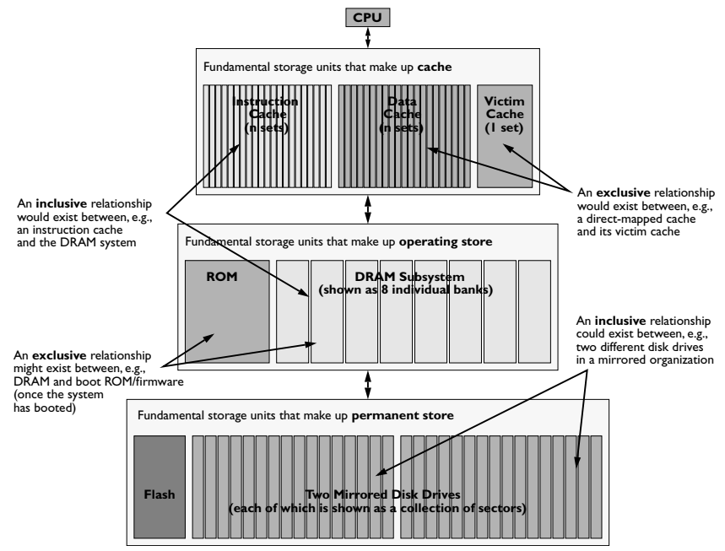
Inclusion and Exclusion
Memory Technologies, Spring 2024, AUT, Tehran, Iran

Slide 8
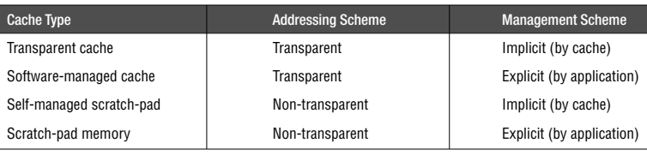
A Taxonomy of Cache Types
Memory Technologies, Spring 2024, AUT, Tehran, Iran

Slide 9
Virtual Addressing
The backing store for a processor cache is usually taken to be main memory: physically addressed
Processor generate virtual addresses
Should caches use the physical address to identify a cached item?
Not necessarily
On each cache access, the cache is indexed, and the tags are compared
Four choices for cache organization
Memory Technologies, Spring 2024, AUT, Tehran, Iran

Slide 10
Cache Addressing
Physically indexed, physically tagged
The cache is indexed and tagged by its physical address
the virtual address must be translated before the cache can be accessed
Pros
since the cache uses the same namespace as physical memory, it can be entirely controlled by hardware, and the operating system need not concern itself with managing the cache.
Cons
Address translation is in the critical path (TLB)
Memory Technologies, Spring 2024, AUT, Tehran, Iran

Slide 11
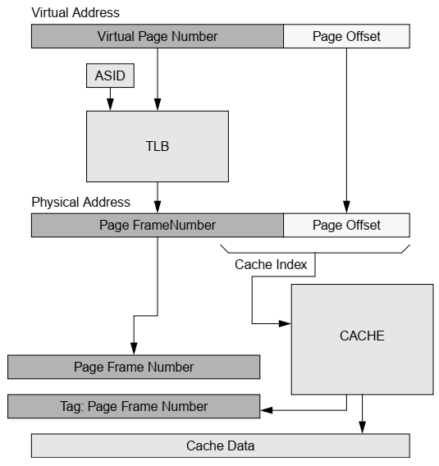
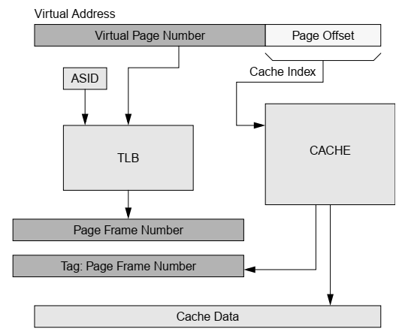
Cache Addressing
Memory Technologies, Spring 2024, AUT, Tehran, Iran

Slide 12
Cache Addressing
Physically indexed, virtually tagged
The cache is indexed by its physical address, but the tag contains the virtual address
If the physical address is available at the start of the procedure, then why not use the physical address as a tag?
If a single physical page is being shared at two different virtual addresses, then there will be contention for the cache line
Pros
The operating system need not perform explicit cache management
Memory Technologies, Spring 2024, AUT, Tehran, Iran

Slide 13
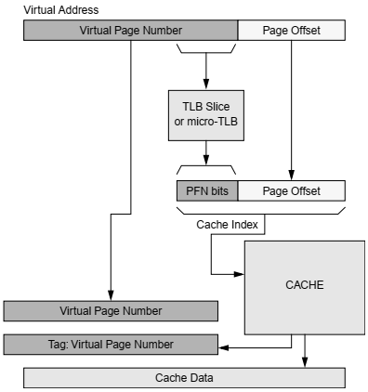
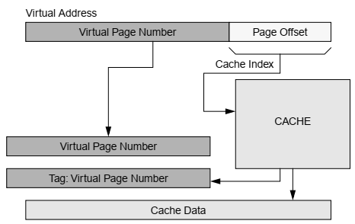
Cache Addressing
Memory Technologies, Spring 2024, AUT, Tehran, Iran

Slide 14
Cache Addressing
Virtually indexed, physically tagged
The cache index is available immediately since it needs no translation, and the tag requires translation
The translation of the virtual address can happen at the same time as the cache index
Address translation is not in the critical path
Pros
Much faster access time than a physically indexed cache
Reduced need for management as compared to a virtually indexed, virtually tagged cache
Hardware can ensure that multiple aliases to the same physical block do not reside in multiple entries of a set
Memory Technologies, Spring 2024, AUT, Tehran, Iran

Slide 15
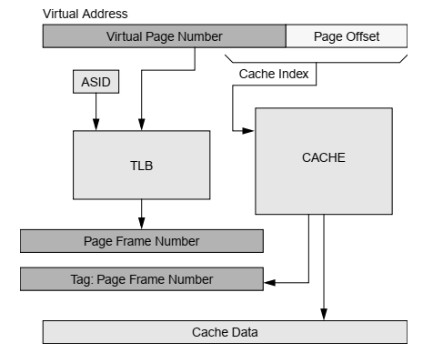
Cache Addressing
Memory Technologies, Spring 2024, AUT, Tehran, Iran

Slide 16
Cache Addressing
Virtually indexed, virtually tagged
The cache is indexed and tagged by the virtual address
Pros
Address translation is not needed anywhere in the process
A translation lookaside buffer is not needed
If one is used, it only needs to be accessed when a requested datum is not in the cache
Memory Technologies, Spring 2024, AUT, Tehran, Iran

Slide 17
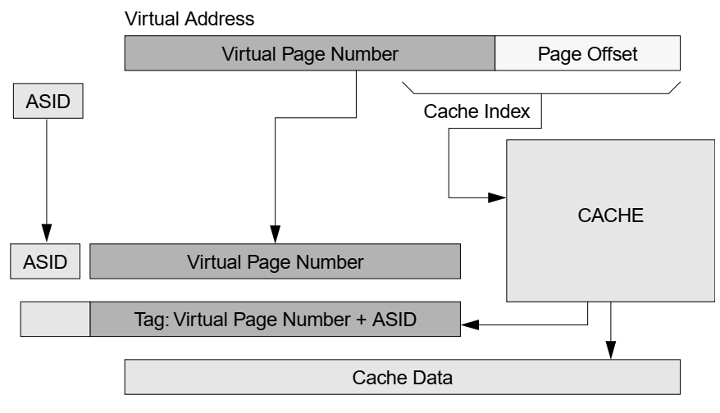
Cache Addressing
Memory Technologies, Spring 2024, AUT, Tehran, Iran

Slide 18
Implementation Issues
Memory Technologies, Spring 2024, AUT, Tehran, Iran

Slide 19
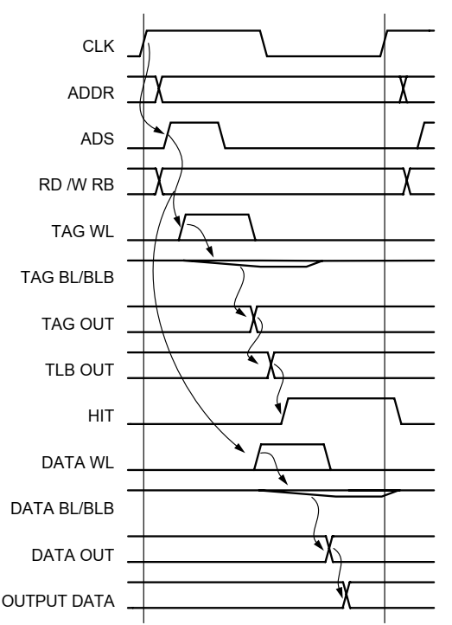
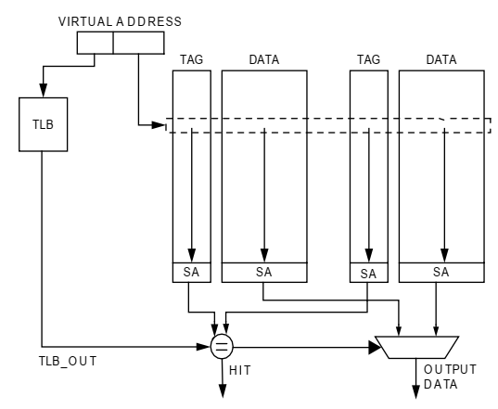
Read Operation
Memory Technologies, Spring 2024, AUT, Tehran, Iran

Slide 20
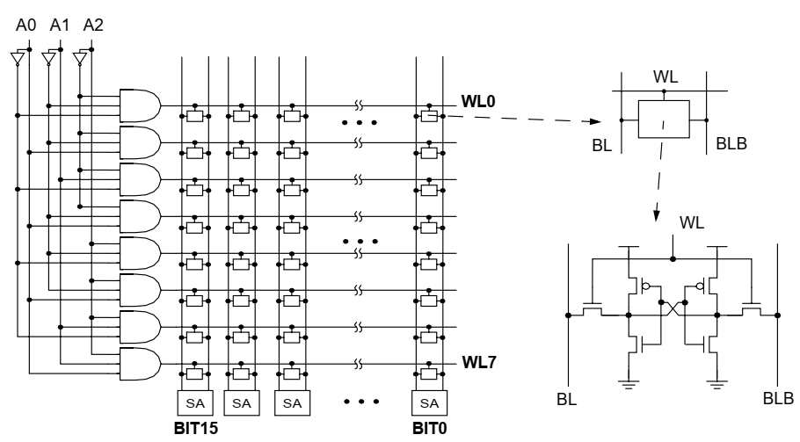
Address Decoding
Memory Technologies, Spring 2024, AUT, Tehran, Iran

Slide 21
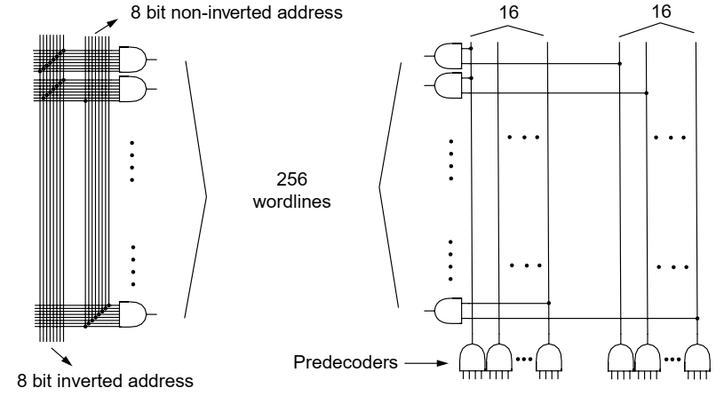
Predecoding
Predecoding: using one level of logic to AND subsets of the address
Minimizing fan-in
Memory Technologies, Spring 2024, AUT, Tehran, Iran

Slide 22
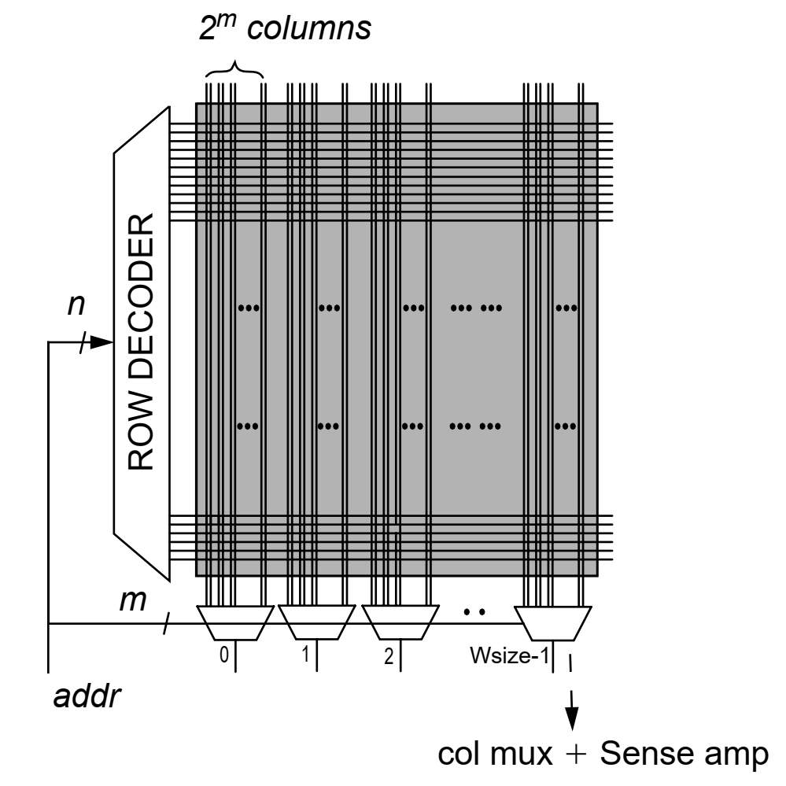
Row and Column Decoding
Two-dimensional decoding
A subset of the address accesses a single row of the array (the row address), and a separate subset is used to select a fraction of all of the columns accessed within the row
Non-Partitioned Decoding
Number of connected cells to the row’s wordlines and the column’s bitlines
Total capacitance and power dissipation
physical lengthening of the SRAM array
increasing the wordline wire length and its parasitic wiring capacitance
More power in the bitlines is wasted during each access
Memory Technologies, Spring 2024, AUT, Tehran, Iran

Slide 23
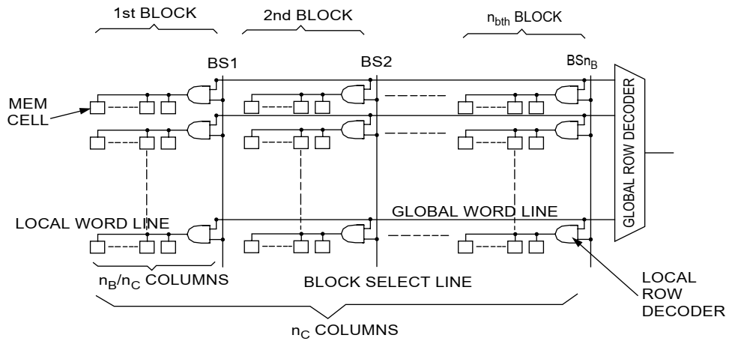
Divided Wordline (DWL)
Dividing the memory array along the top-level wordline
into a fixed number of blocks
Memory Technologies, Spring 2024, AUT, Tehran, Iran

Slide 24
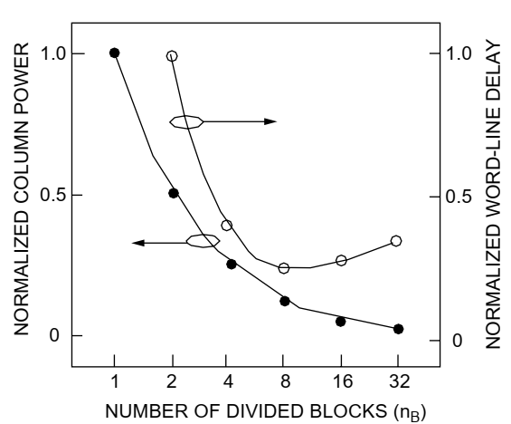
Divided Wordline (DWL)
Partitioning effect on power and delay
8K x 8 SRAM
Memory Technologies, Spring 2024, AUT, Tehran, Iran

